Slide 1


MACHINERY PRODUCTION COMPANY
Demand & Production Optimization
~ Deeksha Saini
(Project - 215)

Slide 2
Business Problem
Project Executives
Data Collection & Project overview & Scope
Project Architecture - Data Flow Diagram
Content
Data Dictionary
Approach
Exploratory Data Analysis & Preprocessing
Data Visualization

Slide 3

Business Problem
The client is facing challenges in accurately predicting demand and planning production for various construction machinery variants. Frequent last-minute changes to product features and fluctuating order volumes lead to production delays, inventory imbalances, and difficulties in meeting dealer and customer demands efficiently.

Slide 4
Project Executives
Business Objective : Maximize operational efficiency and responsiveness
Business Constraint : Minimize stockouts and inventory imbalances
Business Success Criteria : Reduce production lead time by 15%
Economic Success Criteria : Cut inventory holding costs by 10%

Slide 5
Data Collection, Project Overview & Scope
Data Collection : Dataset is provided by the client end.
A Demand and Production Optimization Project focuses on aligning production capabilities with customer demand to maximize efficiency, minimize costs, and improve overall profitability.
The approach taken by me in completing this project is MySQL & Python. Steps I have used in this project are Aggregations, Group by, where condition & other functions to find the answers and draw the relevant insights from the given dataset. I have used Power BI to visualize my findings and to make my ppt look more presentable.

Slide 6
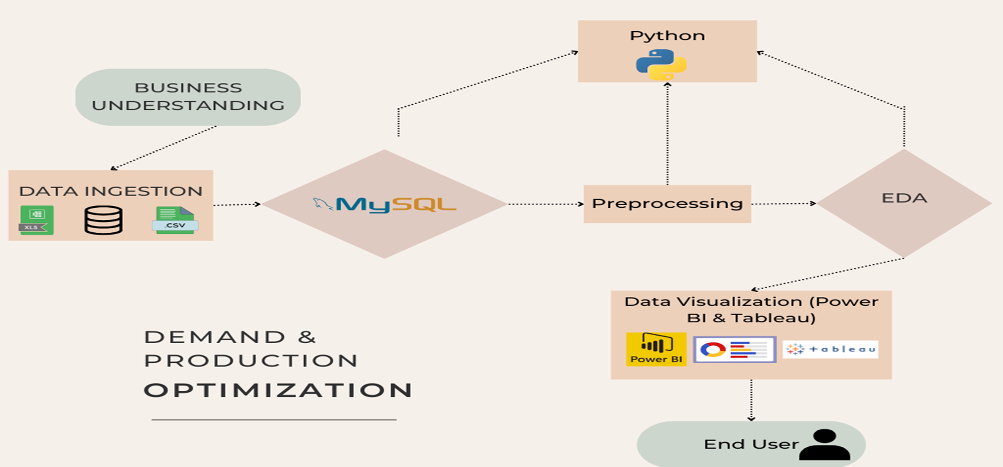
Project Architecture

Slide 7
Data Dictionary
Column Name | Datatypes | Description | Example values
Billing Date | text | Contatins the date values | 2022-08-18 00:00:00
Variant | text | Contains the model of the machineries | XXX11, XXXV2, XXXV4
Economic Index | double | Contains the economic index | 87.45, 145.07, 123.2
Industry Growth Rate (%) | double | Contains the industry growth rate in % | 8.45, 14.54, -2.96
Seasonality Factor | text | Contains the Categorical Data | High, Medium, Low
Back to Agenda

Slide 8


Approach
4-Step Ordering Process
EDA & Preprocessing Steps
MySQL tasks
Findings into meaningful insights
Visualize your findings
Back to Agenda

Slide 9

Exploratory Data Analysis
Statistical & Business Insights
Finding null values :
select count(*) from variants where Economic_Index and `Industry Growth Rate (%)` is null;
# no nulls/missing values are found
Finding duplicates in the dataset :
select Economic_Index, `Industry Growth Rate (%)`, count(*) as count from variants group by Economic_Index, `Industry Growth Rate (%)` HAVING COUNT(*) > 1;
# no duplicates inside the data are found
Count of all the Unique Variants in the dataset :
select count(distinct Variant) from variants;
# 12 Distinct Variants are found inside our data

Slide 10
# List of all the 12 Unique Variants : XXX11, XXX17, XXXV1, XXXV2, XXX12, XXXV4, XXXV5, XXXV3, XXX13, XXX18, XXXV9, XXX15
# Count of Variants :
select Variant, count(*) from variants group by Variant;
FOR ECONOMIC INDEX
select year(`Billing date`), min(`Economic Index`) as min_economic_index from variants group by year(`Billing date`);
# 2022 - 50.32
# 2023 - 50.01
# 2024 - 50
# Finding yearly maximum value of Economic Index :
select year(`Billing date`), max(`Economic Index`) as max_economic_index from variants group by year(`Billing date`);
# 2022 - 149.83
# 2023 - 149.97
# 2024 - 149.94
Sum of Economic_Index per Variant :
select Variant, sum(`Economic Index`) from variants group by Variant;
# Variant with highest economic index value :
select Variant, sum(`Economic Index`) as total_economic_index from variants group by Variant order by total_economic_index desc limit 1;

Slide 11
FOR INDUSTRY GROWTH RATE
Per Year Average of Industry Growth Rate (%) :
select year(`Billing date`), avg(`Industry Growth Rate (%)`) from variants group by year(`Billing date`);
# 2022 - 4.86
# 2023 - 4.83
# 2024 - 4.92
Max industry growth rate (%) by year :
select year(`Billing date`), max(`Industry Growth Rate (%)`) as max_industry_growth_rate from variants group by year(`Billing date`);
# 2022 - 14.94
# 2023 - 14.99
# 2024 - 14.99
Min industry growth rate (%) by year :
select year(`Billing date`), min(`Industry Growth Rate (%)`) as max_industry_growth_rate from variants group by year(`Billing date`);
# 2022 - -4.98
# 2023 - -5
# 2024 - -5
Sum of Industry Growth Rate (%) per Variant :
select Variant, sum(`Industry Growth Rate (%)`) from variants group by Variant;
Back to Agenda

Slide 12
Variant that contributed the highest in Industry Growth Rate(%) :
select Variant, sum(`Industry Growth Rate (%)`) as total_industry_growth_rate from variants group by Variant order by total_industry_growth_rate desc limit 1;
Seasonality factor % wise :
with cte as(
select `Seasonality Factor`, count(`Seasonality Factor`) as count_seasonality_factors from variants group by `Seasonality Factor`
),
cte1 as(
select count(`Seasonality Factor`) as total_seasonality_factors from variants
)
select `Seasonality Factor`, cte.count_seasonality_factors/cte1.total_seasonality_factors * 100 as seasonality_factor_perc from cte join cte1 on 1=1;

Slide 13
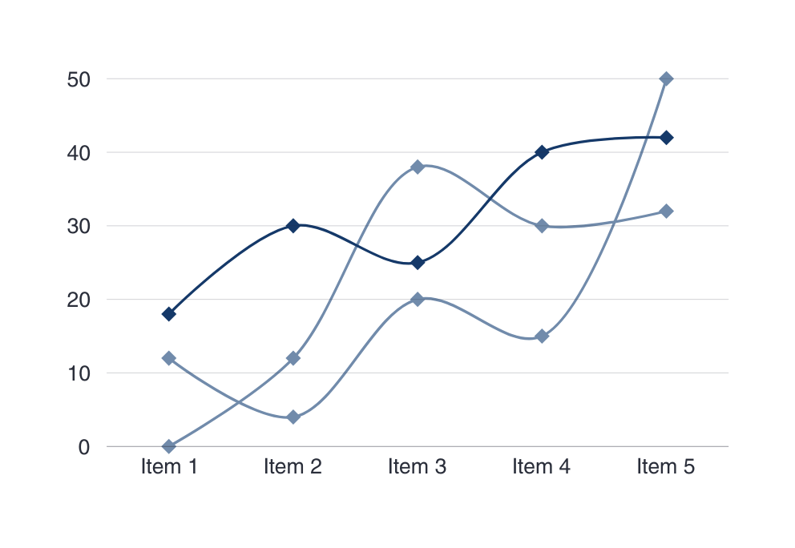
Dashboard
Power BI & Tableau
Monthly Revenue:
10 BILLION
Average Revenue/Customer:
5 BILLION
Monthly Revenue Growth:
1 BILLION

Slide 14
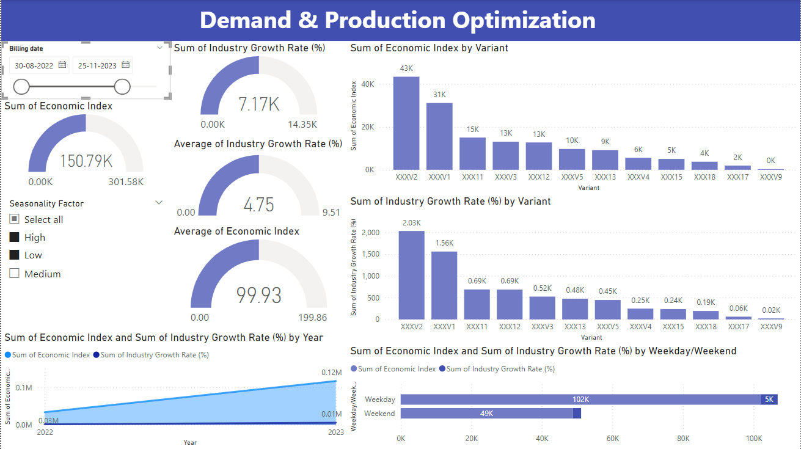

Slide 15
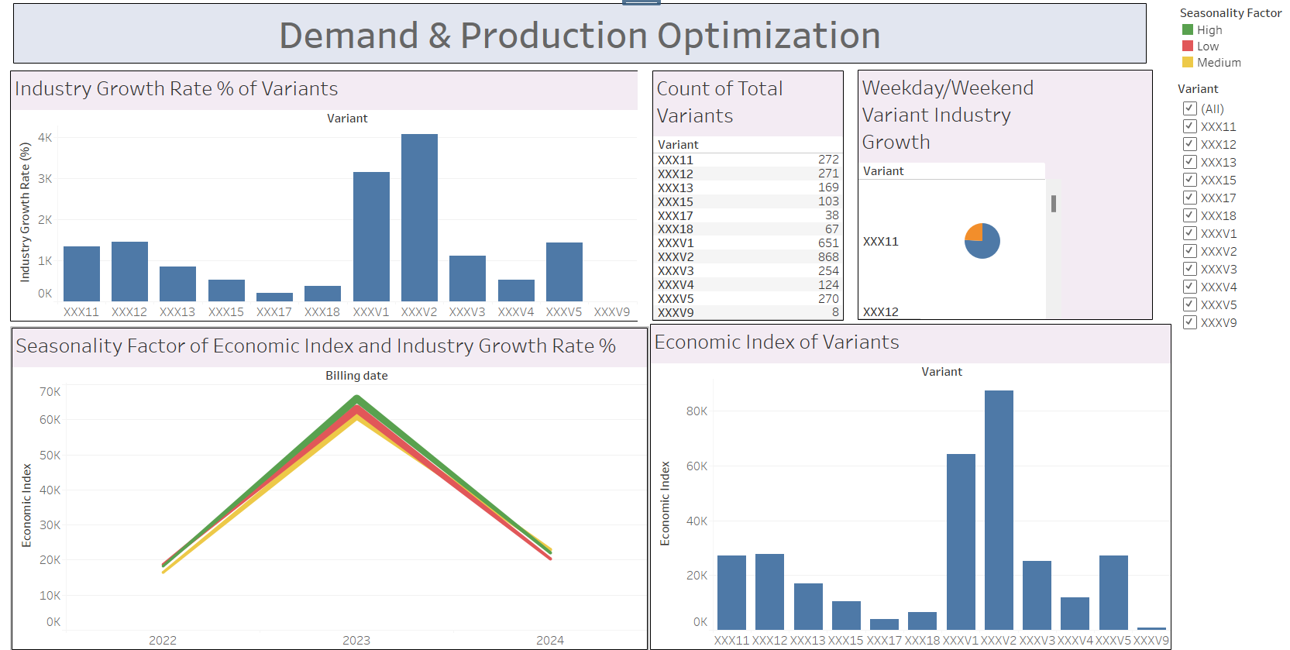

Slide 16
thank
you

